Slide 1


GREEN WORLD INTERNATIONAL KENYA LTD
5th Floor KIPRO CENTER, Sports Road, Westlands, Nairobi, KENYA
Tel. 020-4441416, 0701080902
Email : greenworldkenya@yahoo.com
Website : www.world-food.com

Slide 2

Let us Win the Game !!
Self Building
Credibility
for the Business

Slide 3





How to Start Green World business ?

Slide 4
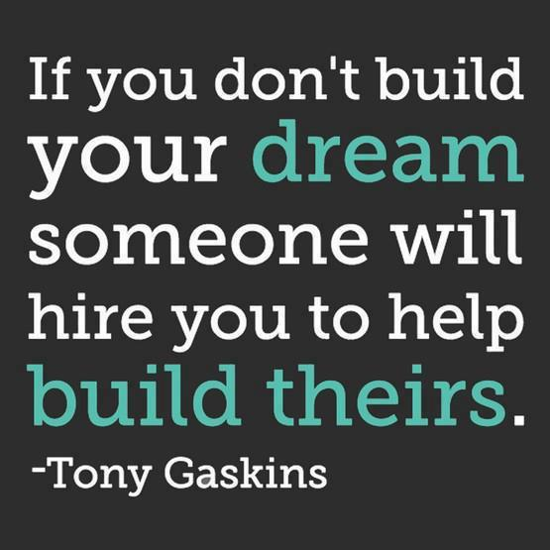

Slide 5
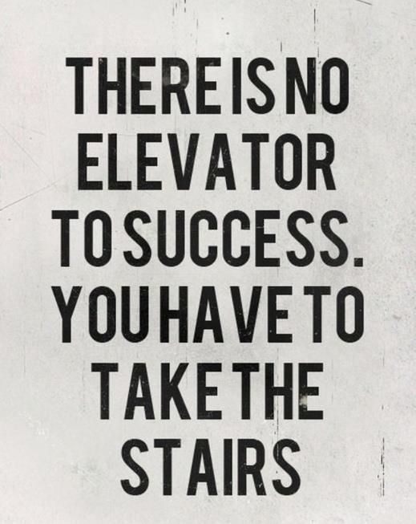
How BIG of Your SUCCESS that you Want ??

Slide 6


BUILD Your CREDIBILITY to Your Green World Business

Slide 7


BUILD Your CREDIBILITY
SELF CONFIDENT

Slide 8
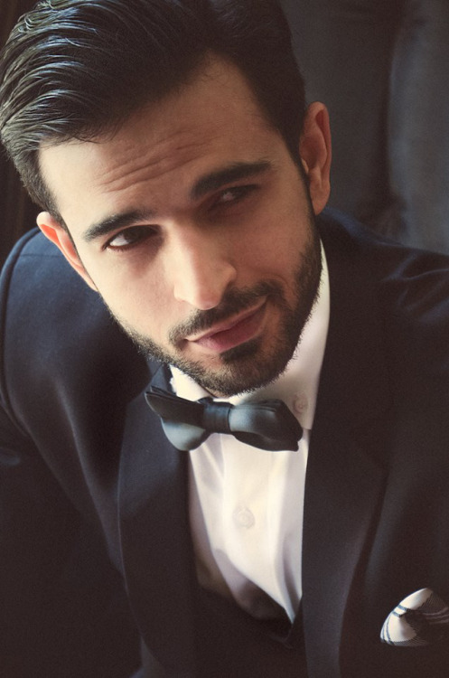
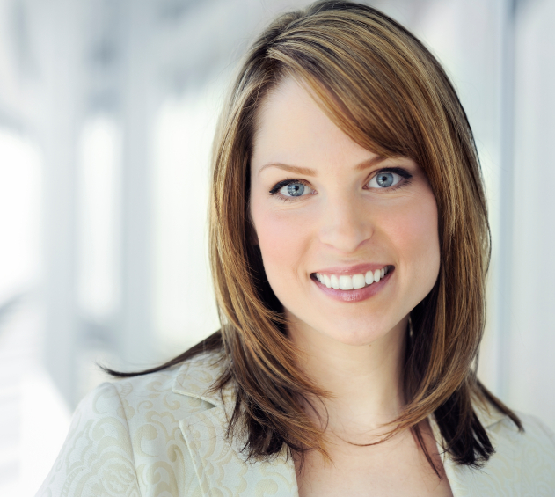
BUILD Your CREDIBILITY
2. VALUE YOURSELF

Slide 9

BUILD Your CREDIBILITY
3. UNDERSTAND THE (OVERALL) PROCESS

Slide 10
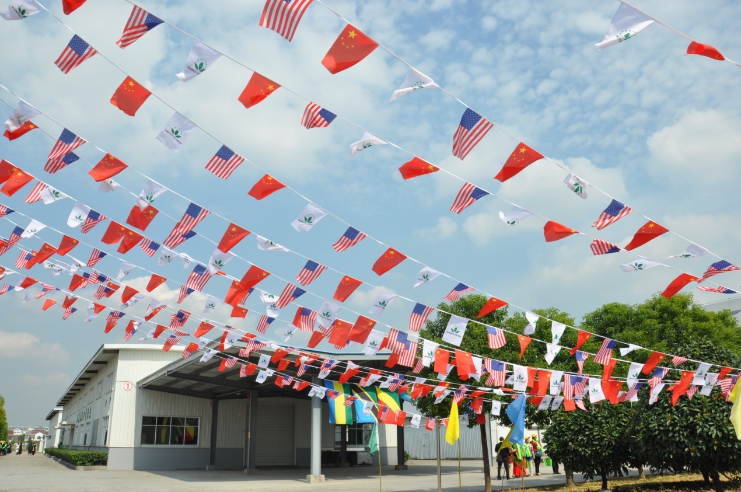
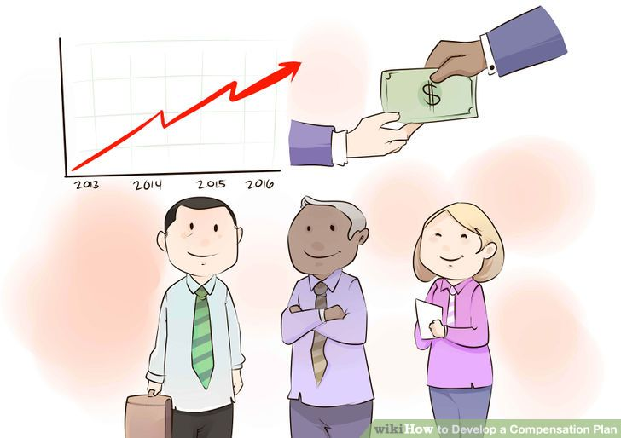
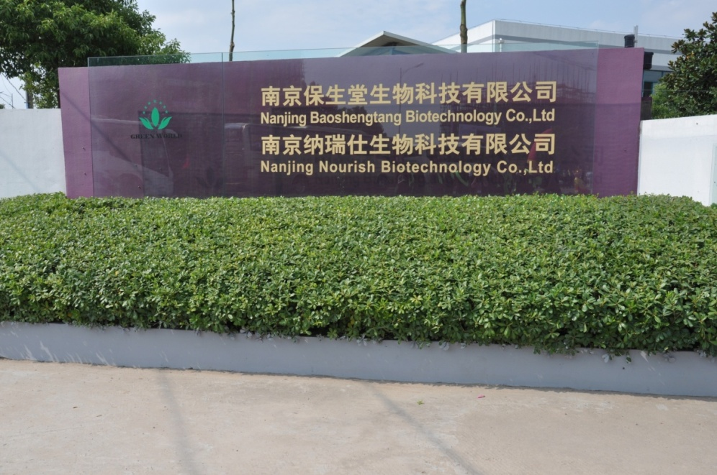













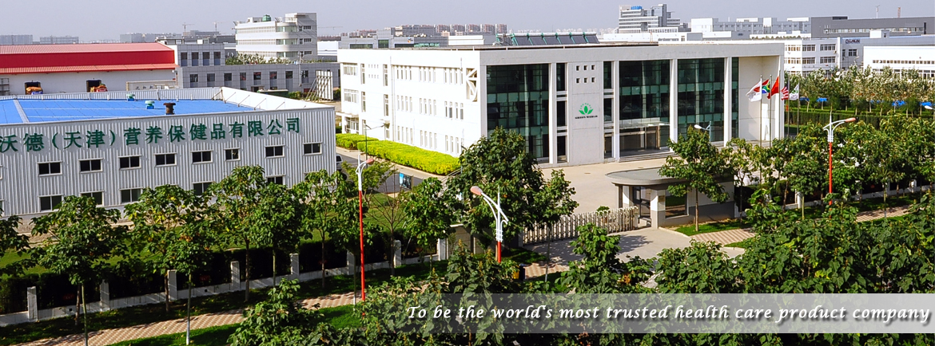









SELF CONFIDENT
1, Self Confident to Your Business
2. Self Confident to Green World Company
3. Self Confident to Green World Products
4. Self Confident to Green World Compensation Plan

Slide 11

DUPLICATION SYSTEM
STAR 3
250 BV
Join Green World with 250 BV (*3)
USE Green World Product for your health and beauty
BUILD YOUR BUSINESS, BUILD YOUR NETWORK by recommend Green World Business to at least 1 person join as STAR 3 (250 bv) every week. DUPLICATE !!
GET READY for your Continuous AWARDS from Green World

Slide 12








HOW TO DUPLICATE
JOIN
250 BV
3*
250 BV
TSH 500,000
3*
250 BV
3*
250 BV
3*
250 BV
3*
250 BV
3*

Slide 13
How to Start ?
3*
250 BV
TSH 500,000
After 1st Month you will be promoted to 4*
250 BV
3*
250 BV
3*
250 BV
3*
250 BV
3*
BONUS = TSH 534,400

Slide 14
How to Start ?
4*
250 BV
TSH 500,000
After 2nd Month you will be promoted to 5*
Copy and Paste
250 BV
3*
250 BV
3*
250 BV
3*
250 BV
3*
3*
3*
3*
3*
3*
3*
3*
3*
3*
3*
3*
3*
3*
3*
3*
3*

Slide 15

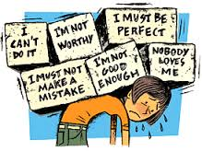
How To Increase Your Self Confident ??

Slide 16
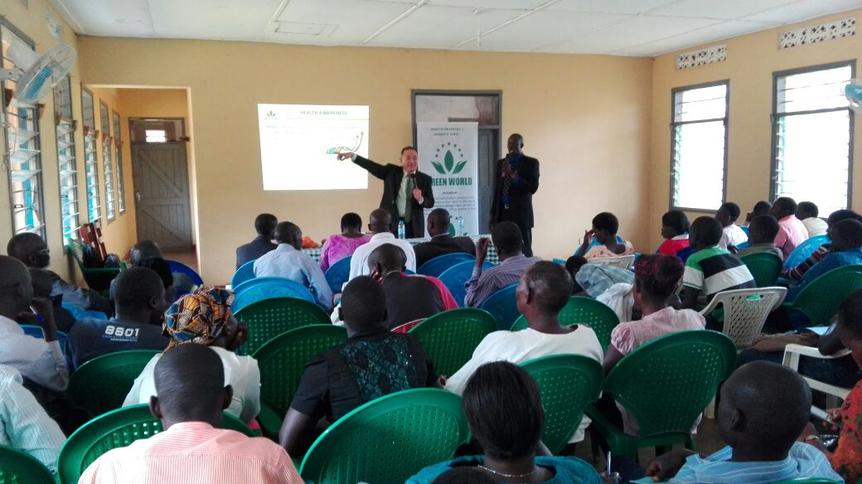

Slide 17
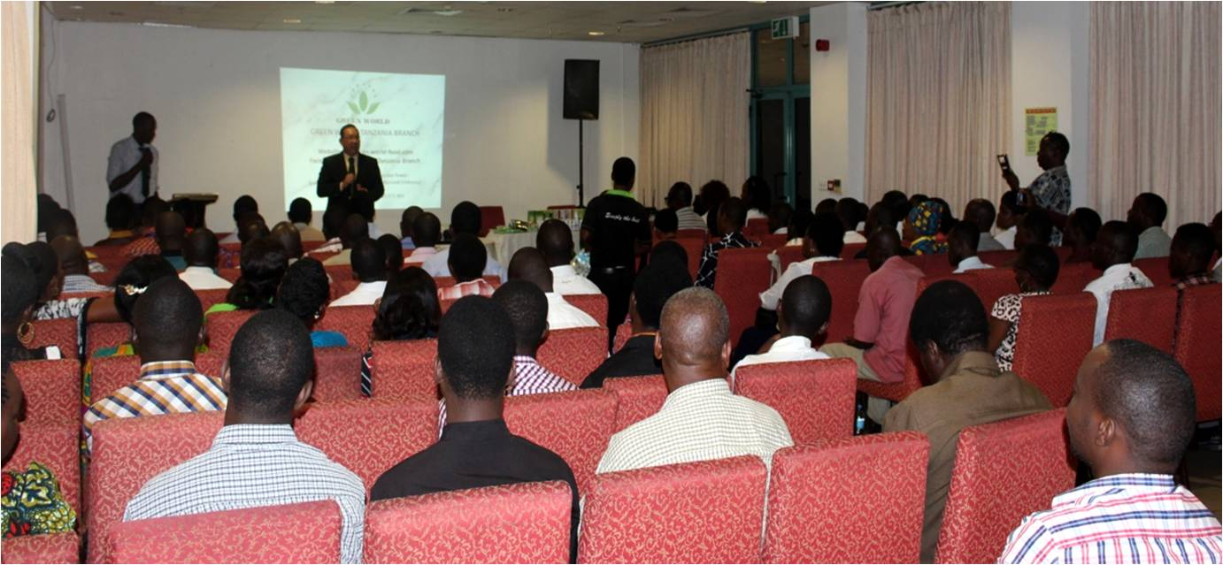

Slide 18


Slide 19
BUILD Your CREDIBILITY
2. VALUE YOURSELF

Slide 20
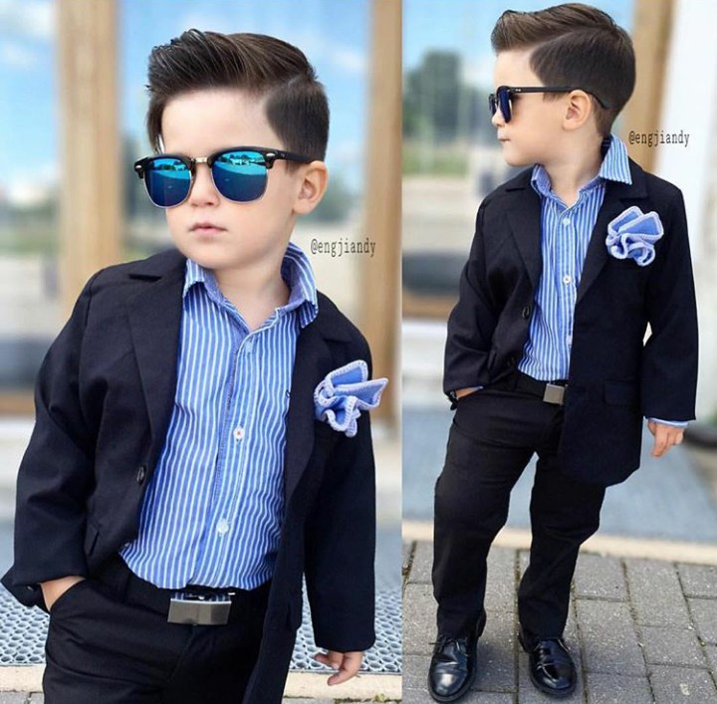
VALUE YOURSELF
1. Appearance

Slide 21


VALUE YOURSELF
2. Language :
Clear, Confident, Polite & Straight to
the point (don’t running around to
unrelated topics)

Slide 22
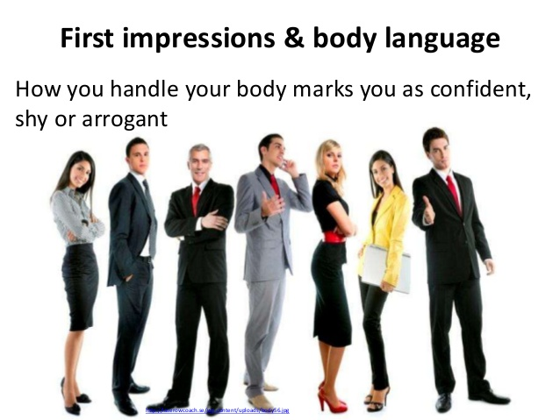
VALUE YOURSELF
3. Body Language :
Watch your first impression to people, your posture, gestures, body language, and your smile

Slide 23
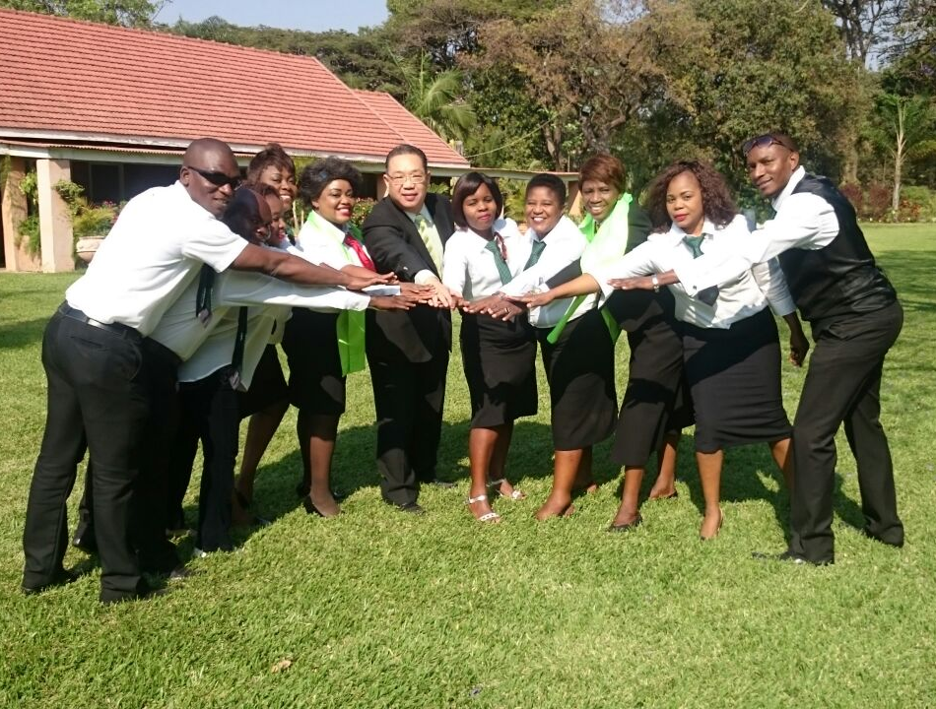
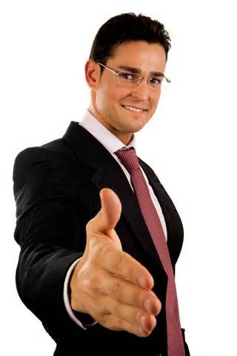
VALUE YOURSELF
4. Attitude (Positive vs Negative)

Slide 24

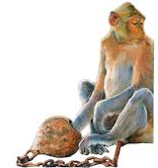
VALUE YOURSELF
4. Attitude (Positive vs Negative)

Slide 25
BUILD Your CREDIBILITY
3. UNDERSTAND THE (OVERALL) PROCESS

Slide 26

UNDERSTAND THE (OVERALL) PROCESS
Understand the Business Process,
Step by Step
1. Make A List of Your Prospects )

Slide 27

1. Make A List of Your Prospects (50 - 100 Names)
WHO ARE YOUR PROSPECT ??
Competitor distributor, Businessman, Employee, lecturer or teacher, College/University Student, housewives ?
We have to Categorize our Prospect as those who are Ambitious, Business Minded or Consumer

Slide 28

UNDERSTAND THE (OVERALL) PROCESS
2. Invite your prospect to
Green World Opportunity
Presentation
Methods :
Send messages through email, online social media, direct phone call or direct invitation.
Find the key person in your community, give a sight of Business Opportunity for his/her community or organization, invite them to be the first person.
Use the tools (product brochures, starter kit, etc) or use the QRMA machine to attract the prospects.

Slide 29

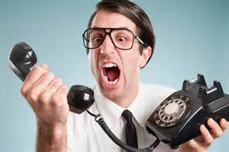
Let us Win the Game !!
Invite minimum 5 New Prospects to every
Green World Opportunity Presentation

Slide 30
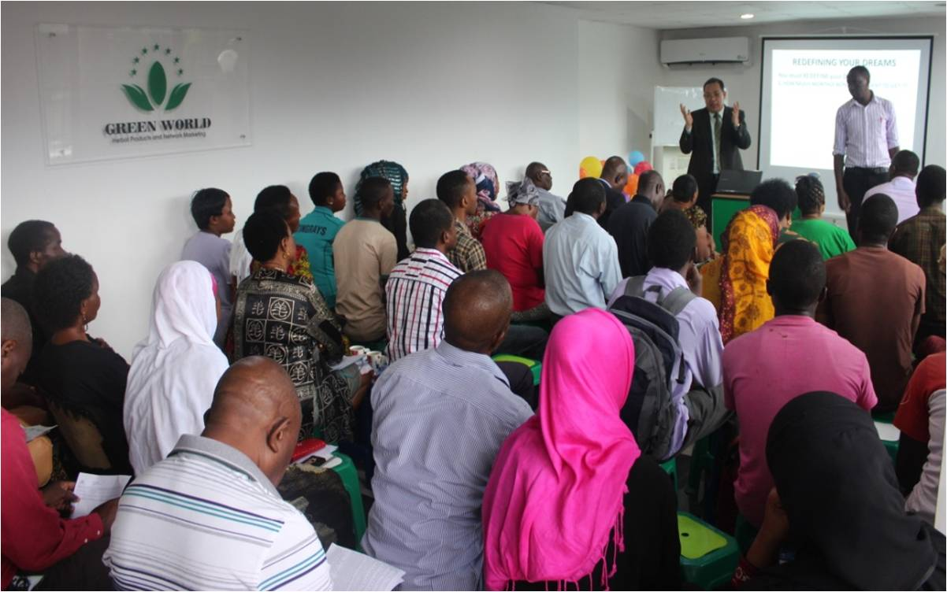
UNDERSTAND THE (OVERALL) PROCESS
3. Follow the Green World Opportunity
Presentation with your New Prospects
Watch Out your behavior and attitude during the Presentation

Slide 31

UNDERSTAND THE (OVERALL) PROCESS
4. Closing & Follow Up
Closing on the spot
Follow up the chosen package (*)
Follow up New Distributor Training
Follow up New Invitation by the new
signed distributors
Follow up your team activity
Follow up for more trainings,
event & presentation

Slide 32
UNDERSTAND THE (OVERALL) PROCESS
5. Administration Procedure
Application Form (How to signup New Distributor
Product Order Form (How to Order Products)
Sales period, Closing Date, Upgrade time limit
Bonus cash out procedure
Network printout by online system or manual
International trip calculation
Business Car terms and condition
Luxury Car terms and condition
House Fund award term and condition

Slide 33

UNDERSTAND THE (OVERALL) PROCESS
6. Manage your Team (Leadership)

Slide 34
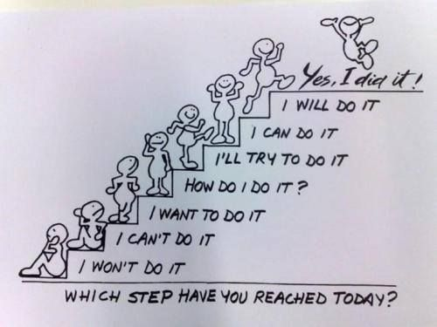

Slide 35

YOUR COMMITMENT
Follow the system
Have your DREAMS and set your GOALS
Willing to Learn and Willing to Transfer the Learning.
Build the business by bring more people
Follow the Presentation and Trainings
Do personal presentation
Never Give Up
Just keep Moving Forward
SUCCESS is YOURS

Slide 36
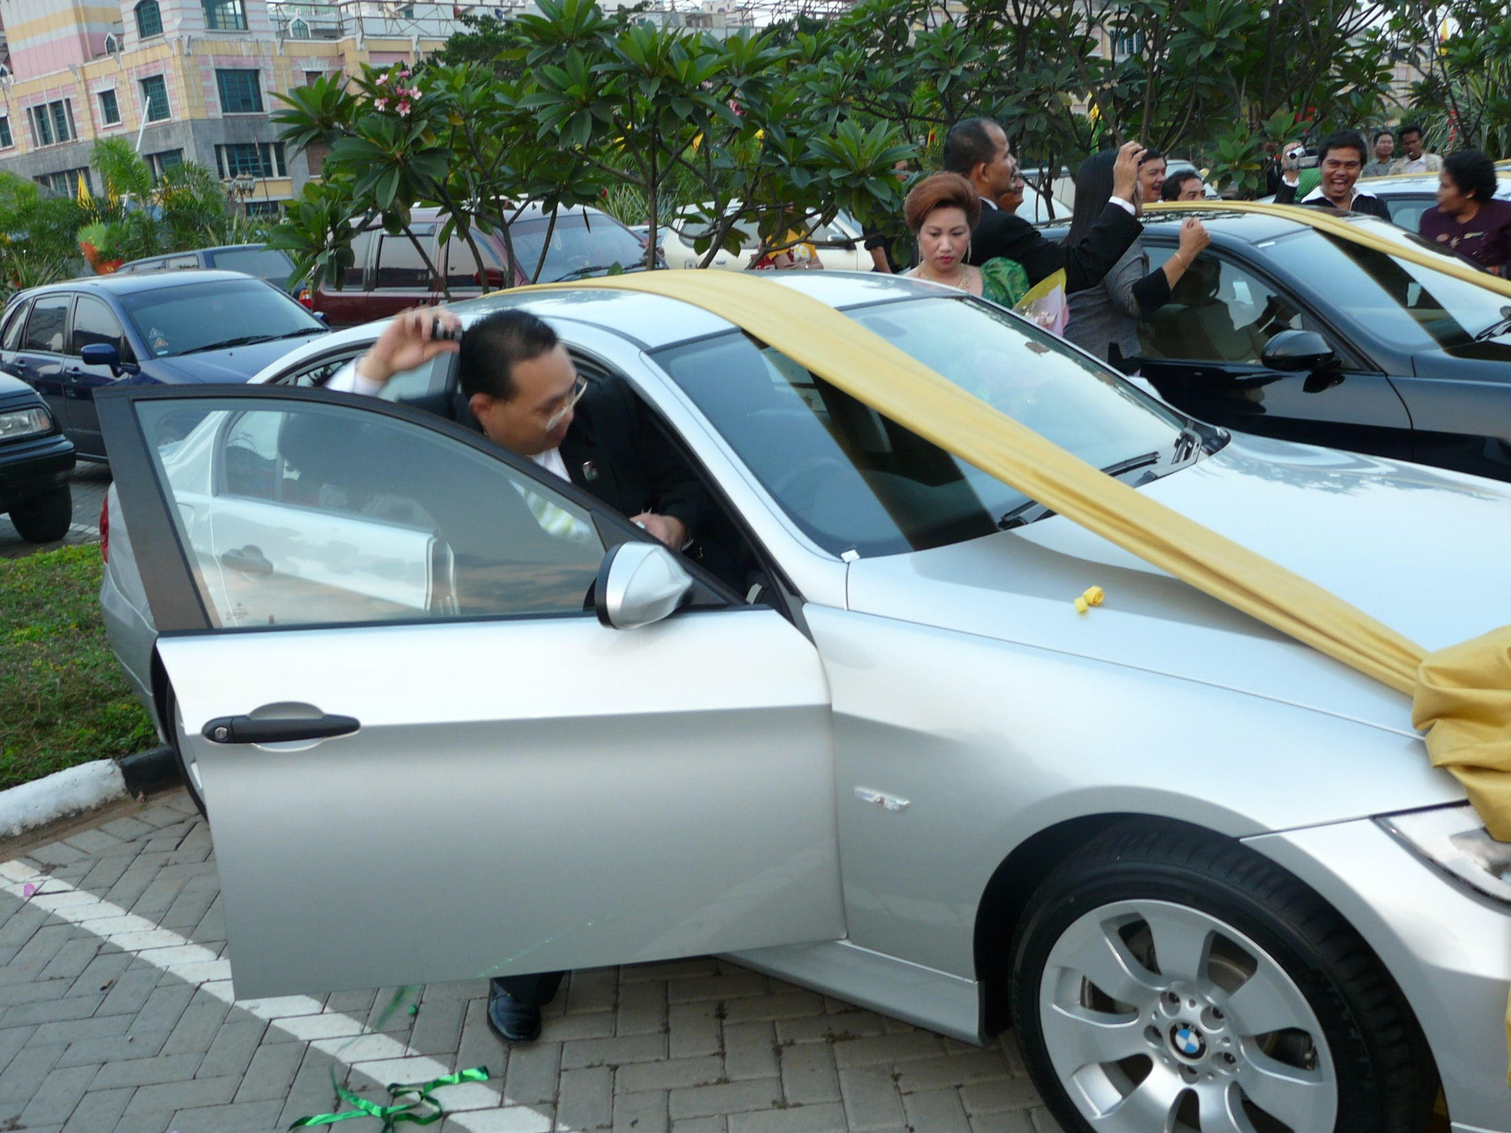
SEE YOU AT THE TOP

